Slide 1
What is System?
Systems process input signals to produce output signals
A system is combination of elements that manipulates one or more signals to accomplish a function and produces some output.
input signal
output signal
system

Slide 2
A system is defined as an entity that acts on an input signal and transforms it into an output signal. A system may also be defined as a set of elements or functional blocks which are connected together and produces an output in response to an input signal. The response or output of the system depends on the transfer function of the system. It is a cause and effect relation between two or more signals

Slide 3
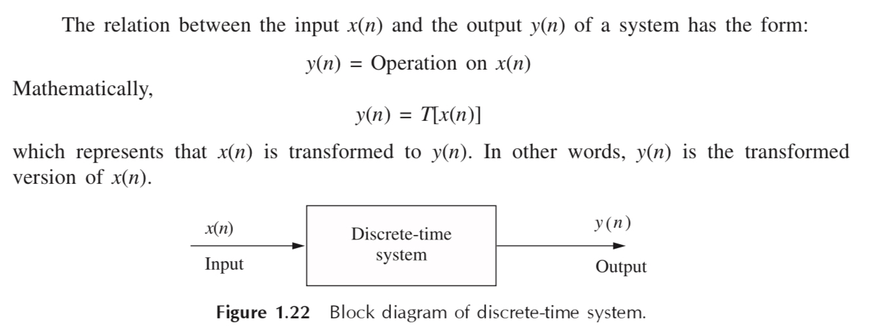

Slide 4
Types of Systems
Causal & Non causal or Anticausal
Linear & Non Linear
Time Variant &Time-invariant
Stable & Unstable
Static & Dynamic

Slide 5
Causal & Anticausal Systems
Causal system : A system is said to be causal if the present value of the output signal depends only on the present and/or past values of the input signal.
Causal systems are real-time systems and physically realisable.
Example: y[n]=x[n]+1/2x[n-1]

Slide 6
Causal & Anticausal Systems Contd.
Anticausal system : A system is said to be anticausal if the present value of the output signal depends only on the future values of the input signal.
They’re not real time.
y(n) = x(n) + x(2n)
y(n) = x2(n) + 2x(n + 2)

Slide 7
A system is said to be defined as non causal, when
a) the output at the present depends on the input at an earlier time b) the output at the present does not depend on the factor of time at all c) the output at the present depends on the input at the current time d) the output at the present depends on the input at a time instant in the future

Slide 8
d

Slide 9
Which one of the following systems is causal?
a) y(t)=x(t)+x(t-3)+x(t²)
b) y(n)=x(n+2)
c) y(t)=x(t-1)+x(t-2)
d) y(n)=x(2n²)

Slide 10
c

Slide 11
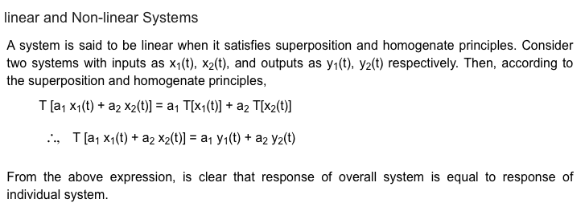
Linear & Non Linear Systems

Slide 12
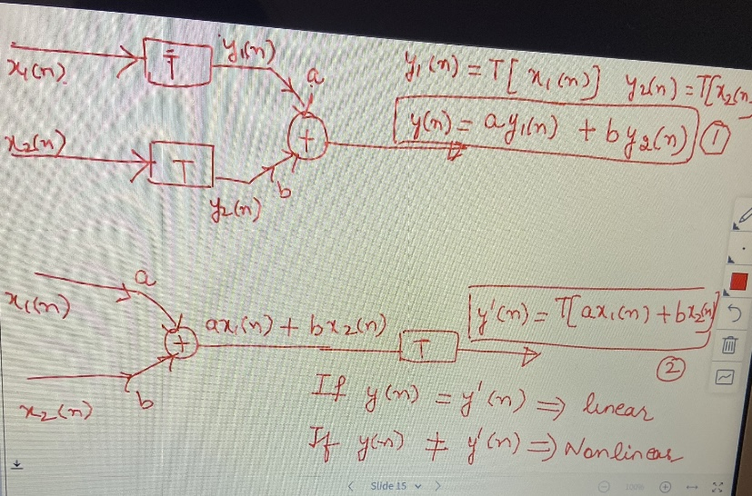

Slide 13
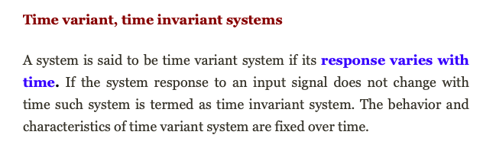
Time Invariant and Time Variant Systems
A system is said to be time invariant if a time delay or time advance of the input signal leads to a identical time shift in the output signal.

Slide 14
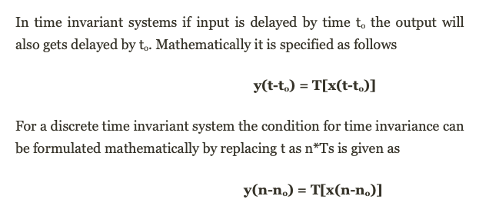

Slide 15
Stable & Unstable Systems
A system is said to be bounded-input bounded-output stable (BIBO stable) if every bounded input results in a bounded output.

Slide 16
For an LTI discrete system to be stable, the sum of the impulse response should be
a) Integral multiple of 2pi b) Infinity c) Finite d) Zero

Slide 17
c

Slide 18
Stable & Unstable Systems Contd.
Example: The system represented by
y(t) = A x(t) is unstable ; A˃1
Reason: let us assume x(t) = u(t), then at every instant u(t) will keep on multiplying with A and hence it will not be bonded.

Slide 19
When we take up design of systems, ideally how do we define the stability of a system?
a) A system is stable, if a bounded input gives a bounded output, for some values of the input
b) A system is unstable, if a bounded input gives a bounded output, for all values of the input
c) A system is stable, if a bounded input gives a bounded output, for all values of the input
d) A system is unstable, if a bounded input gives a bounded output, for some values of the input

Slide 20
c

Slide 21
Static & Dynamic Systems
A static system is memoryless system
It has no storage devices
its output signal depends on present values of the input signal
For example

Slide 22
Static & Dynamic Systems Contd.
A dynamic system possesses memory
It has the storage devices
A system is said to possess memory if its output signal depends on past values and future values of the input signal

Slide 23
Which of the following system is static
A Y(t)= x(t+3)
B Y(t)=x(t+5)
C Y(t)=x²(t)
D Y(t)=x(t-3)

Slide 24
c

